Slide 1
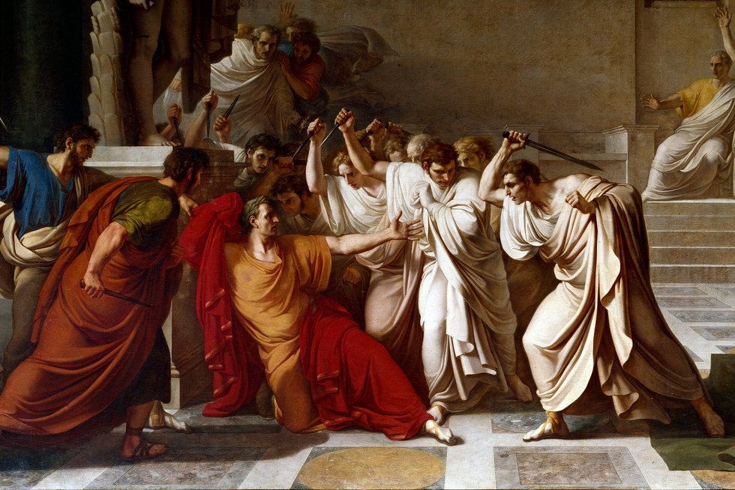
The Punic Wars and political factions
GOAL/S: Outline Rome after the Punic Wars
Describe the political factions of Populares and Optimates
Week 3, Lesson 3

Slide 2
Upcoming Lessons:
We will be learning the historical context in which Tiberius and Gaius Gracchus came to power. It is important to understand this context, to understand these key people and the society in which they operated.
Thursday: Rome after the Punic Wars AND the Populares/Optimates
Friday: The Land Crisis

Slide 3
The Punic Wars
A series of conflicts between Rome and Carthage
The First Punic War (264–241 BCE)
resulted in Rome gaining control of Sicily, marking its first overseas province
The Second Punic War (218–201 BCE)
saw the famous Carthaginian general Hannibal invading Italy but ultimately ending with Rome's victory
The Third Punic War (149–146 BCE)
led to the destruction of Carthage, solidifying Rome's dominance in the Mediterranean
These wars significantly expanded Rome's territorial control, increased wealth through plunder and tribute, and exposed Rome to new cultural influences
Notes:
Carthage (Arabic: قَرْطَاج, romanized: Qarṭāj) was an ancient city on the eastern side of the Lake of Tunis in what is now Tunisia.

Slide 4
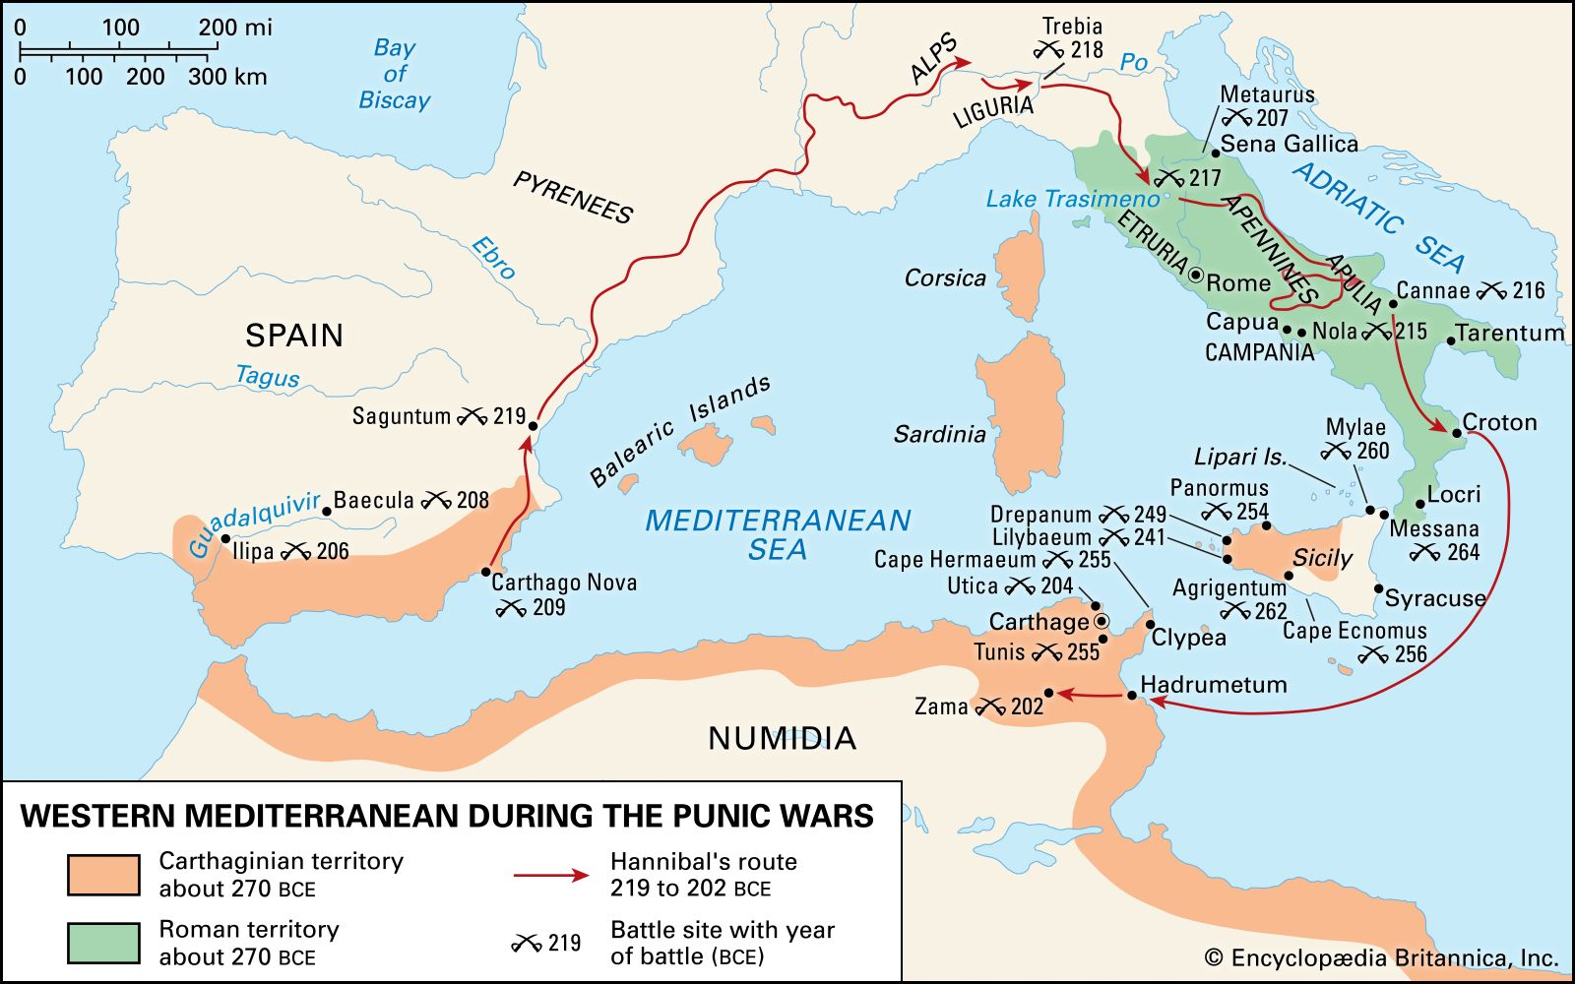

Slide 5
Emergence of Political Factions - Populares and Optimates
In the aftermath of the Punic Wars, Rome experienced internal challenges related to governance, wealth distribution, and the integration of new territories. The political landscape became characterised by the emergence of two major factions: the Populares and the Optimates.

Slide 6
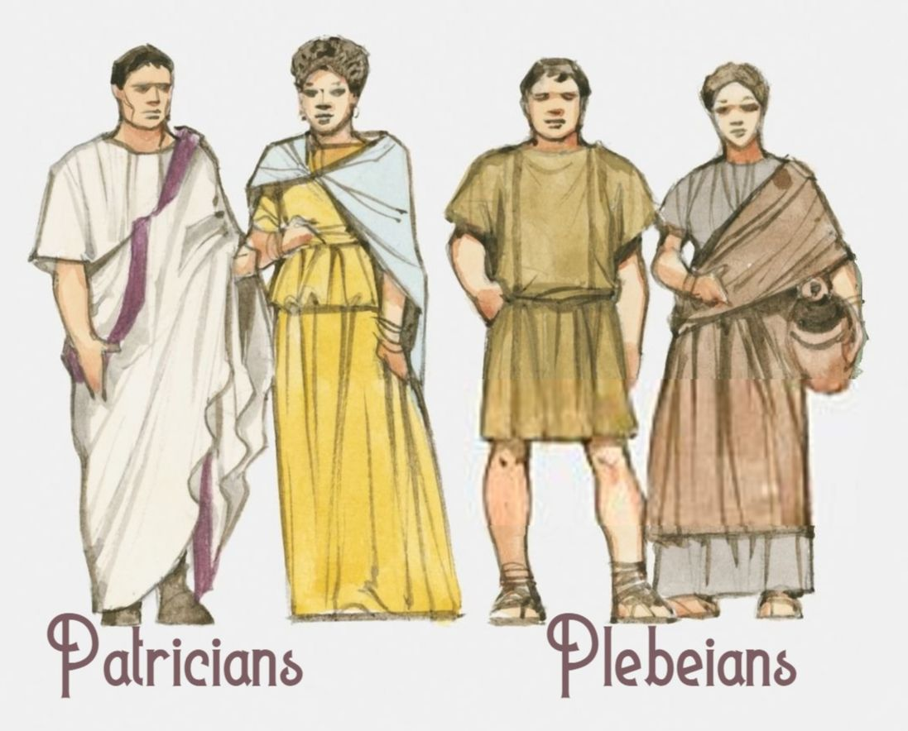
Populares
Represented the interests of the common people (plebeians).
Supported land reforms, distribution of land to veterans, and policies that appealed to the masses.
Leaders associated with the Populares faction included Gaius Marius.
Po-pu-la-res

Slide 7
Optimates
Comprised the conservative aristocracy (patricians and wealthy elites).
Favoured maintaining the existing social and political order, preserving the privileges of the aristocracy.
Leaders associated with the Optimates faction included Lucius Cornelius Sulla.
Op-ti-ma-tes

Slide 8
ACTIVITY – Research Task
Each student will receive a Research Task worksheet.
Choose ONE (1) member of the Populares and ONE (1) member of the Optimates from the list provided.
You must research the following for each person:
Background: Birth, family, early life.
Political Ideology: Beliefs, policies, and alliances.
Contributions: Notable actions, reforms, or military achievements.
THIS MUST BE COMPLETED BY THE END OF THE LESSON or it becomes homework.

